Slide 1

Department of Computer Science &Engineering Artificial Intelligence & Machine Learning A.P. Shah Institute of Technology G.B.Road,Kasarvadavli, Thane(W), Mumbai-400615 UNIVERSITY OF MUMBAI Academic Year 2022-2023

Slide 2
Khoj-Ngo
Computer Science & Engineering
Artificial Intelligence and Machine Learning
By
Tanisha Chitnis(21106003)
Abhishek Bapat(21106008)
Avantika Aher(21106047)
Shlok Dalvi(21106012)
Under the Guidance of
Prof. Shraddha Shinde

Slide 3
Index
Introduction
Objectives
Features
Literature survey
Block Diagram
Tools/Software, Languages used
Implementation
Conclusion
References

Slide 4
Introduction
NGO’s proves to be helpful in serious social issues and finding one when in immediate need is another tough task.
Our NGO finder App brings common public and NGO’s on one platform.
This resolves various social issues without the intervention of third person.
This in turn avoids deceit to the needy person and the person who’s helping.

Slide 5
Objective
To enable transparency between common people and NGO’s
It provides easy access to our NGO’s.
This resolves various social issues without the intervention of third person.
This in turn prevents deception of the needy people and the person who’s helping.

Slide 6
Literature Survey
Sr. No | Title | Author Name | Description
1. | Going to Scale: A Case Study of an Indian Educational NGO (Springer) | Panchali Guha | This paper uses a case study of an Indian educational NGO that has scaled up rapidly and effectively in order to explore the reasons for choice of scaling-up strategy, the particular barriers to scaling-up in the education sector, and how these barriers can be overcome.
2. | Growth of an NGO: The Indian Institute of Cerebral Palsy from 1974 to 2006 (Wiley online Library) | 1.Reena Sen, 2.Juliet Goldbart, 3.Sudha Kaul | Described is the history of the IICP and the strategy this organization used to develop itself into a primary service provider in Eastern India. The case study approach is reflective of the manner that NGO’s with local or regional responsibility to develop model services, can organize services and provides a “lessons learned” model for organizations to undertake similar development.

Slide 7
Literature Survey
Sr. No | Title | Author Name | Description
3. | The NGO sector in India: historical context and current discourse (Springer) | 1.D.L.Sheth, 2.Harsh Sethi | Conversion of voluntarism has changed into a sector. Reorientation of voluntarism is required to promote self governance in true sense.
4. | Converting Android Native Apps to Flutter Cross-Platform Apps (IEEE XPLORE) | 1.Yoonsik Cheon, 2.Carlos Chavez | A Flutter version of an existing Android app is created to support both Android and iOS by rewriting the entire app in Flutter. Development experience by discussing technical issues, problems, and challenges associated with it is shared.

Slide 8
Literature Survey
Sr. No | Title | Author Name | Description
5. | Performance and stability Comparison of React and Flutter: Cross-platform Application Development (IEEE XPLORE) | 1.Kamal Kishore, 2.Shanu Khare, 3.Vaibhav Uniyal, 4.Sahil Verma | This research paper presents the study and comparison of ReactJs and Flutter. Contains a comparison of the performance of applications developed by these technologies.

Slide 9
BLOCK DIAGRAM

Slide 10






DONOR
ADMINISTRATOR
NGO
Help
Donate
Assist the Development
Financial Aid
Human rights and Child rights
Poverty Eradication
Prevent Social Injustice
Conservation of Environment

Slide 11





Tools/software, Languages used
Flutter
Android Studio
VS code
Dart
Firebase

Slide 12
PROJECT WORK

Slide 13
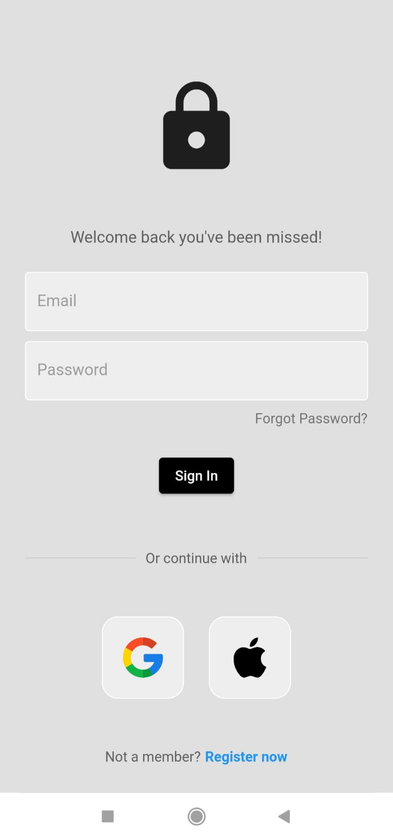
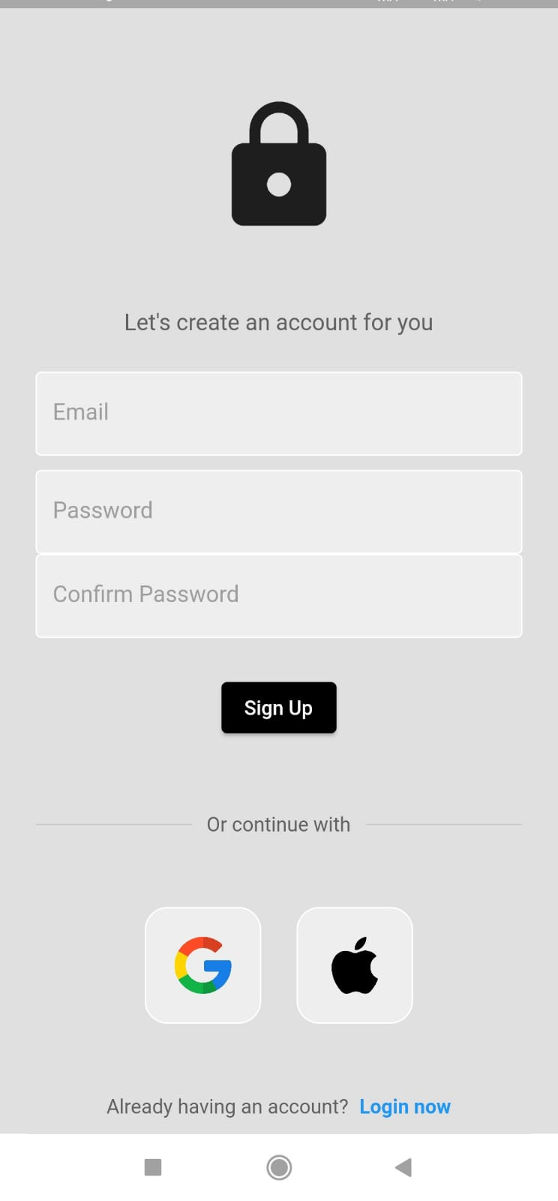
Implementation
Sign in page
Register page

Slide 14
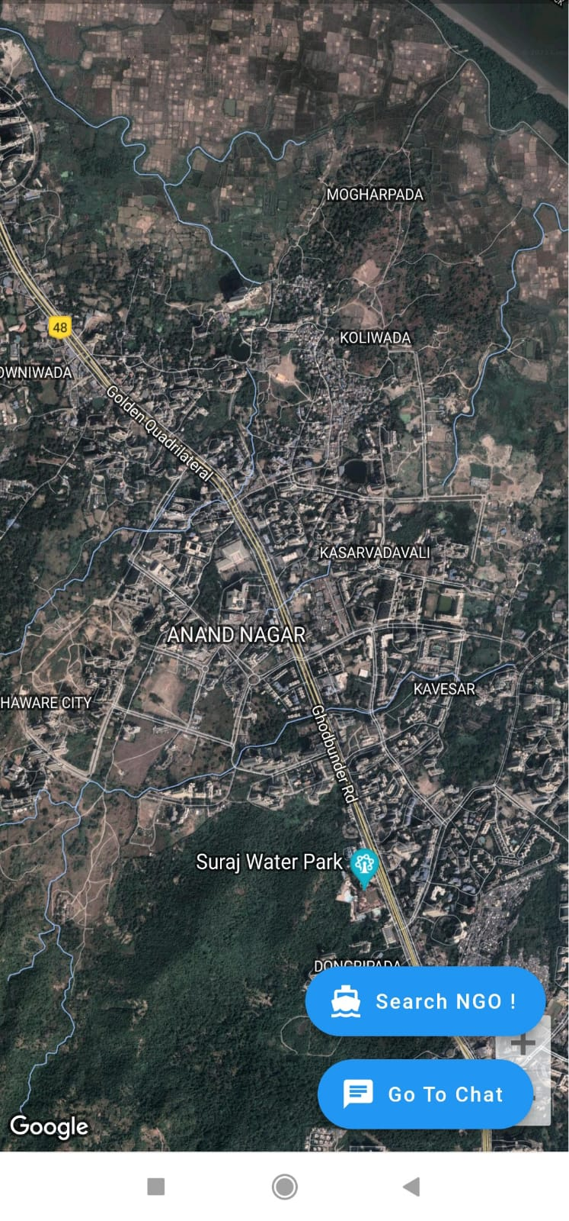
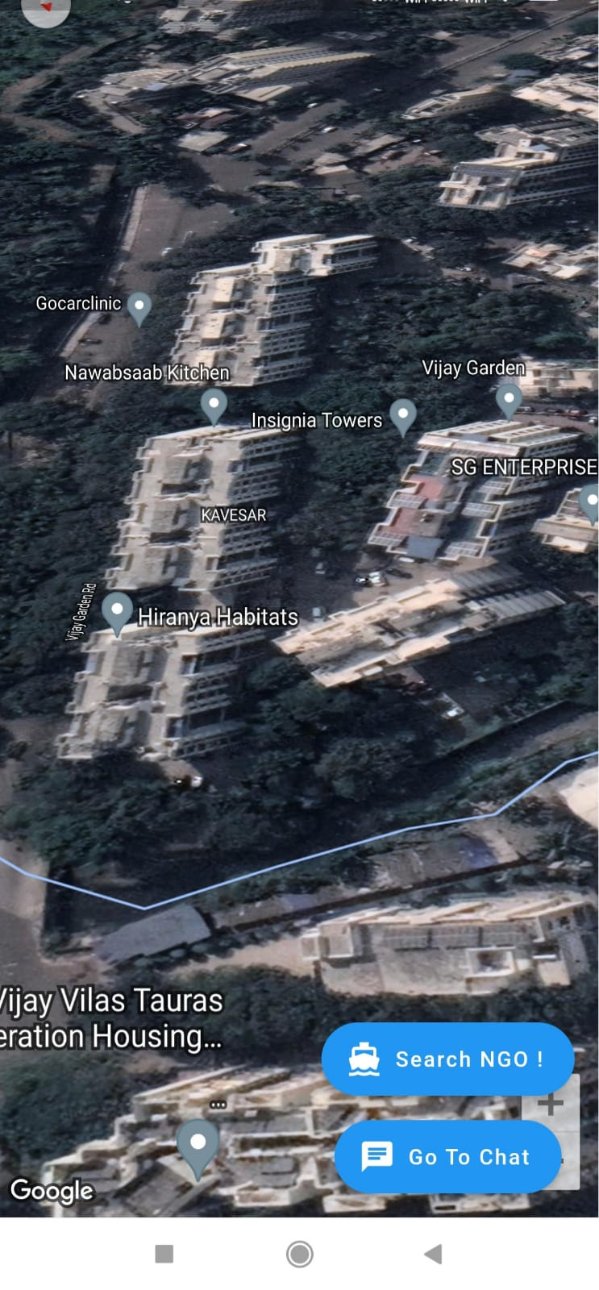
Maps Page (Before Searching)
Maps Page (After Searching)

Slide 15
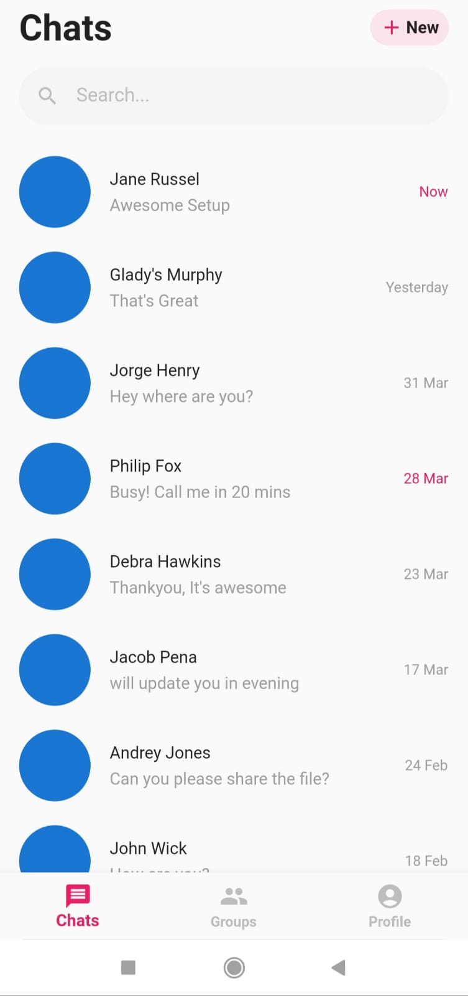
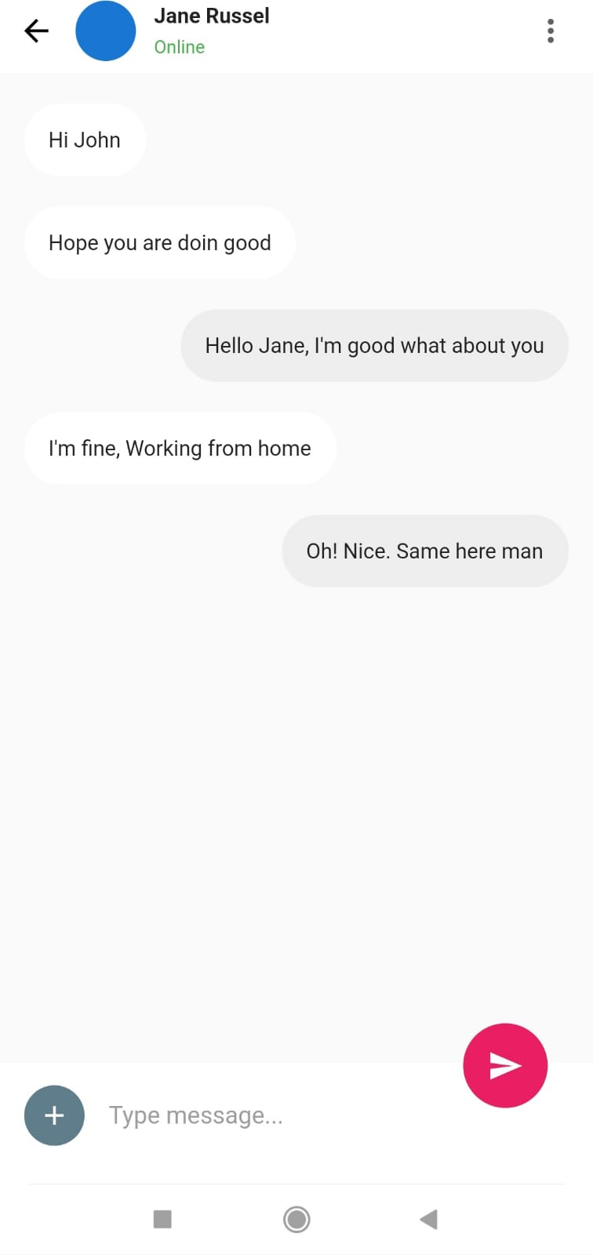
Chat Interface(1.1)
Chat Interface(1.2)

Slide 16
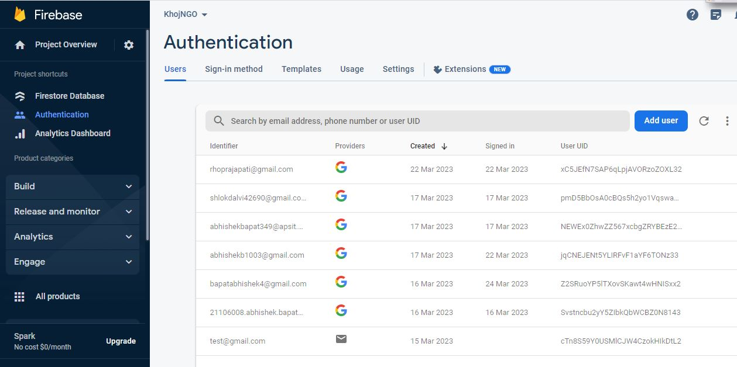
Firebase

Slide 17
Conclusion
A successful real-time NGO finder app KhojNGO is built.
This app rightly serves the purpose of people who wish to help in social issues thus contacting the NGO directly .
Google map help the user to locate the nearest NGO and chat interface helps the user to communicate with the NGO .
Chat interface helps people to communicate with the NGO.

Slide 18
References
Journal Papers
[1] Guha, Panchali. "Going to scale: A case study of an Indian educational NGO." VOLUNTAS: International Journal of Voluntary and Nonprofit Organizations 30, no. 6 (2019): 1365-1379.
[2] Sen, Reena, Juliet Goldbart, and Sudha Kaul. "Growth of an NGO: The Indian institute of cerebral palsy from 1974 to 2006." Journal of Policy and Practice in Intellectual Disabilities 5, no. 2 (2008): 105-111.
[3] Sheth, D. L., and Harsh Sethi. "The NGO sector in India: historical context and current discourse." Voluntas: International Journal of Voluntary and Nonprofit Organizations 2, no. 2 (1991): 49-68.
[4] Cheon, Yoonsik, and Carlos Chavez. "Converting Android Native Apps to Flutter Cross-Platform Apps." In 2021 International Conference on Computational Science and Computational Intelligence (CSCI), pp. 1898-1904. IEEE, 2021.
[5] Kishore, Kamal, Shanu Khare, Vaibhav Uniyal, and Sahil Verma. "Performance and stability Comparison of React and Flutter: Cross-platform Application Development." In 2022 International Conference on Cyber Resilience (ICCR), pp. 1-4. IEEE, 2022.

Slide 19
Useful Links
[6] https://docs.flutter.dev/
[6] https://docs.flutter.dev/
[7] https://www.udemy.com/course/learn-flutter-dart-to-build-ios-android-apps/
[8] https://youtu.be/Dh-cTQJgM-Q
[9] https://youtu.be/15alBbc53gs
[10] https://youtu.be/7844jKWKIe0

